Slide 1

Determining the tau decay constant for a guitar sound wave
By: Andrew Krupien, Jeanne Gandon, Emilie Letourneau, and Tejes Gaertner

Slide 2
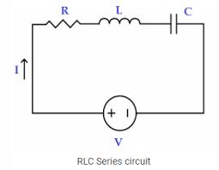
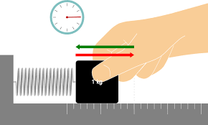
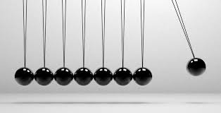
Damped Linear Oscillators
RLC Circuit: Vibrating Spring: Pendulum:

Slide 3
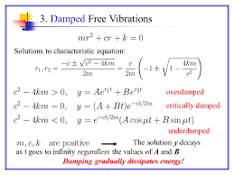
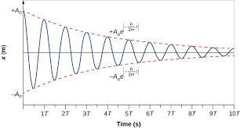
Mathematics of Damped Linear Oscillators

Slide 4


Guitar sound wave’s behavior
Fundamental equations and assumptions:
f=(√(T/U))/2L
Amplitude decay= A0e^-t/tau
Tau=1/n*gamma
A0=(a^2+b^2)^½
a and b are constant found after
Solving the characteristic equation

Slide 5
Hypothesis
Measure the intensity of a sound wave produced by guitars of varying linear mass density
the initial amplitude and frequency for a steel guitar string should be higher than a brass guitar string
the decay constant tau should be higher for each nth increase in harmonic
because steel has a lower linear mass density than brass and an increase in harmonic correlates to a greater number of oscillations per second.

Slide 6
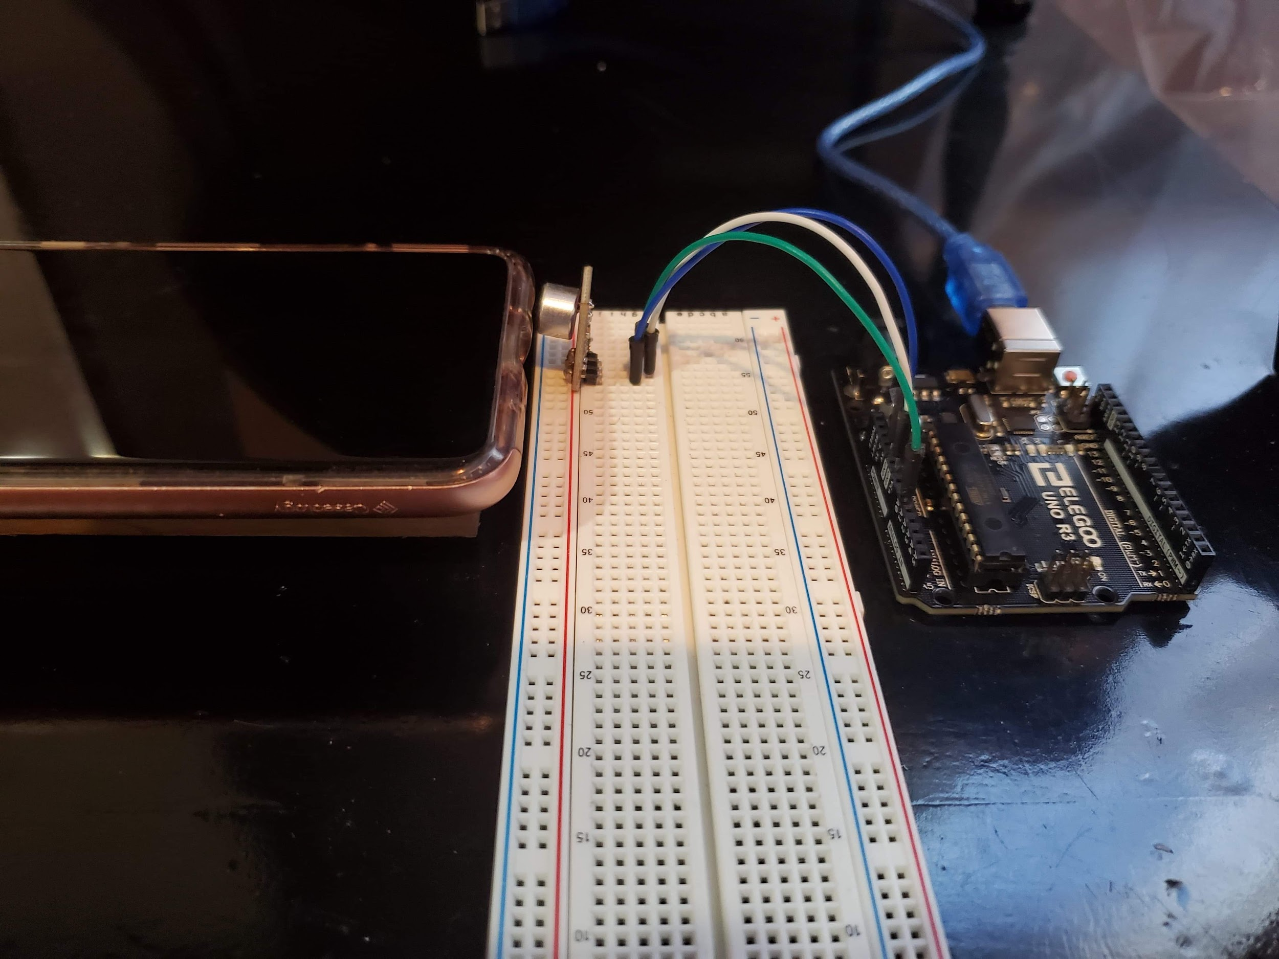
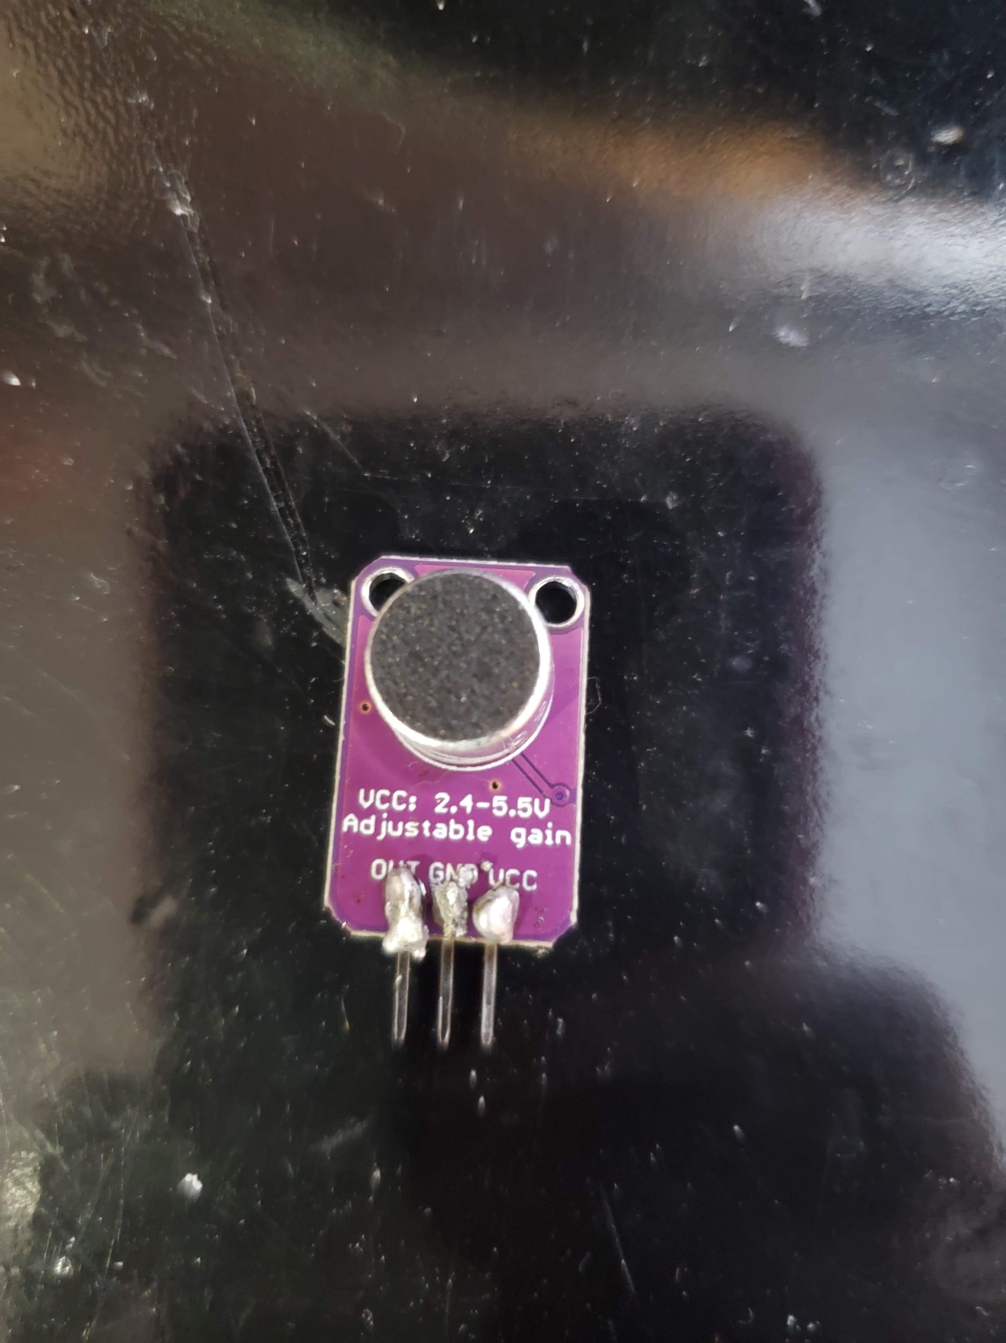
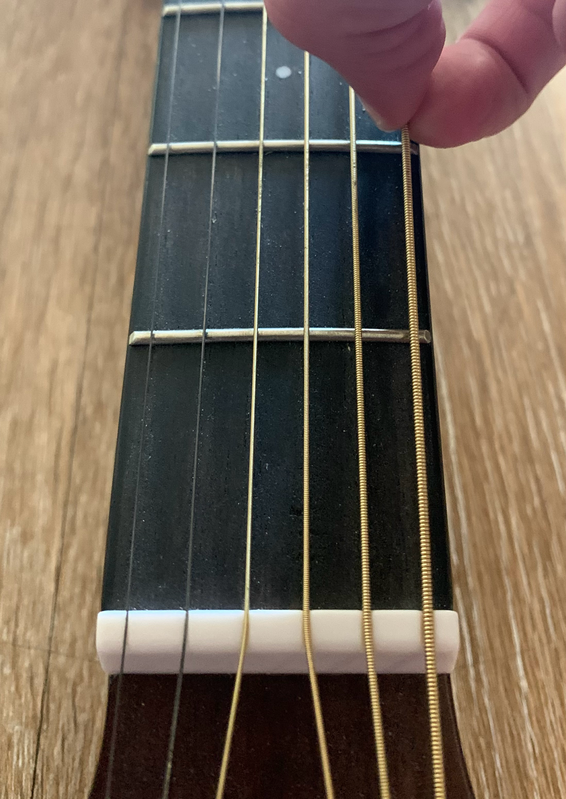
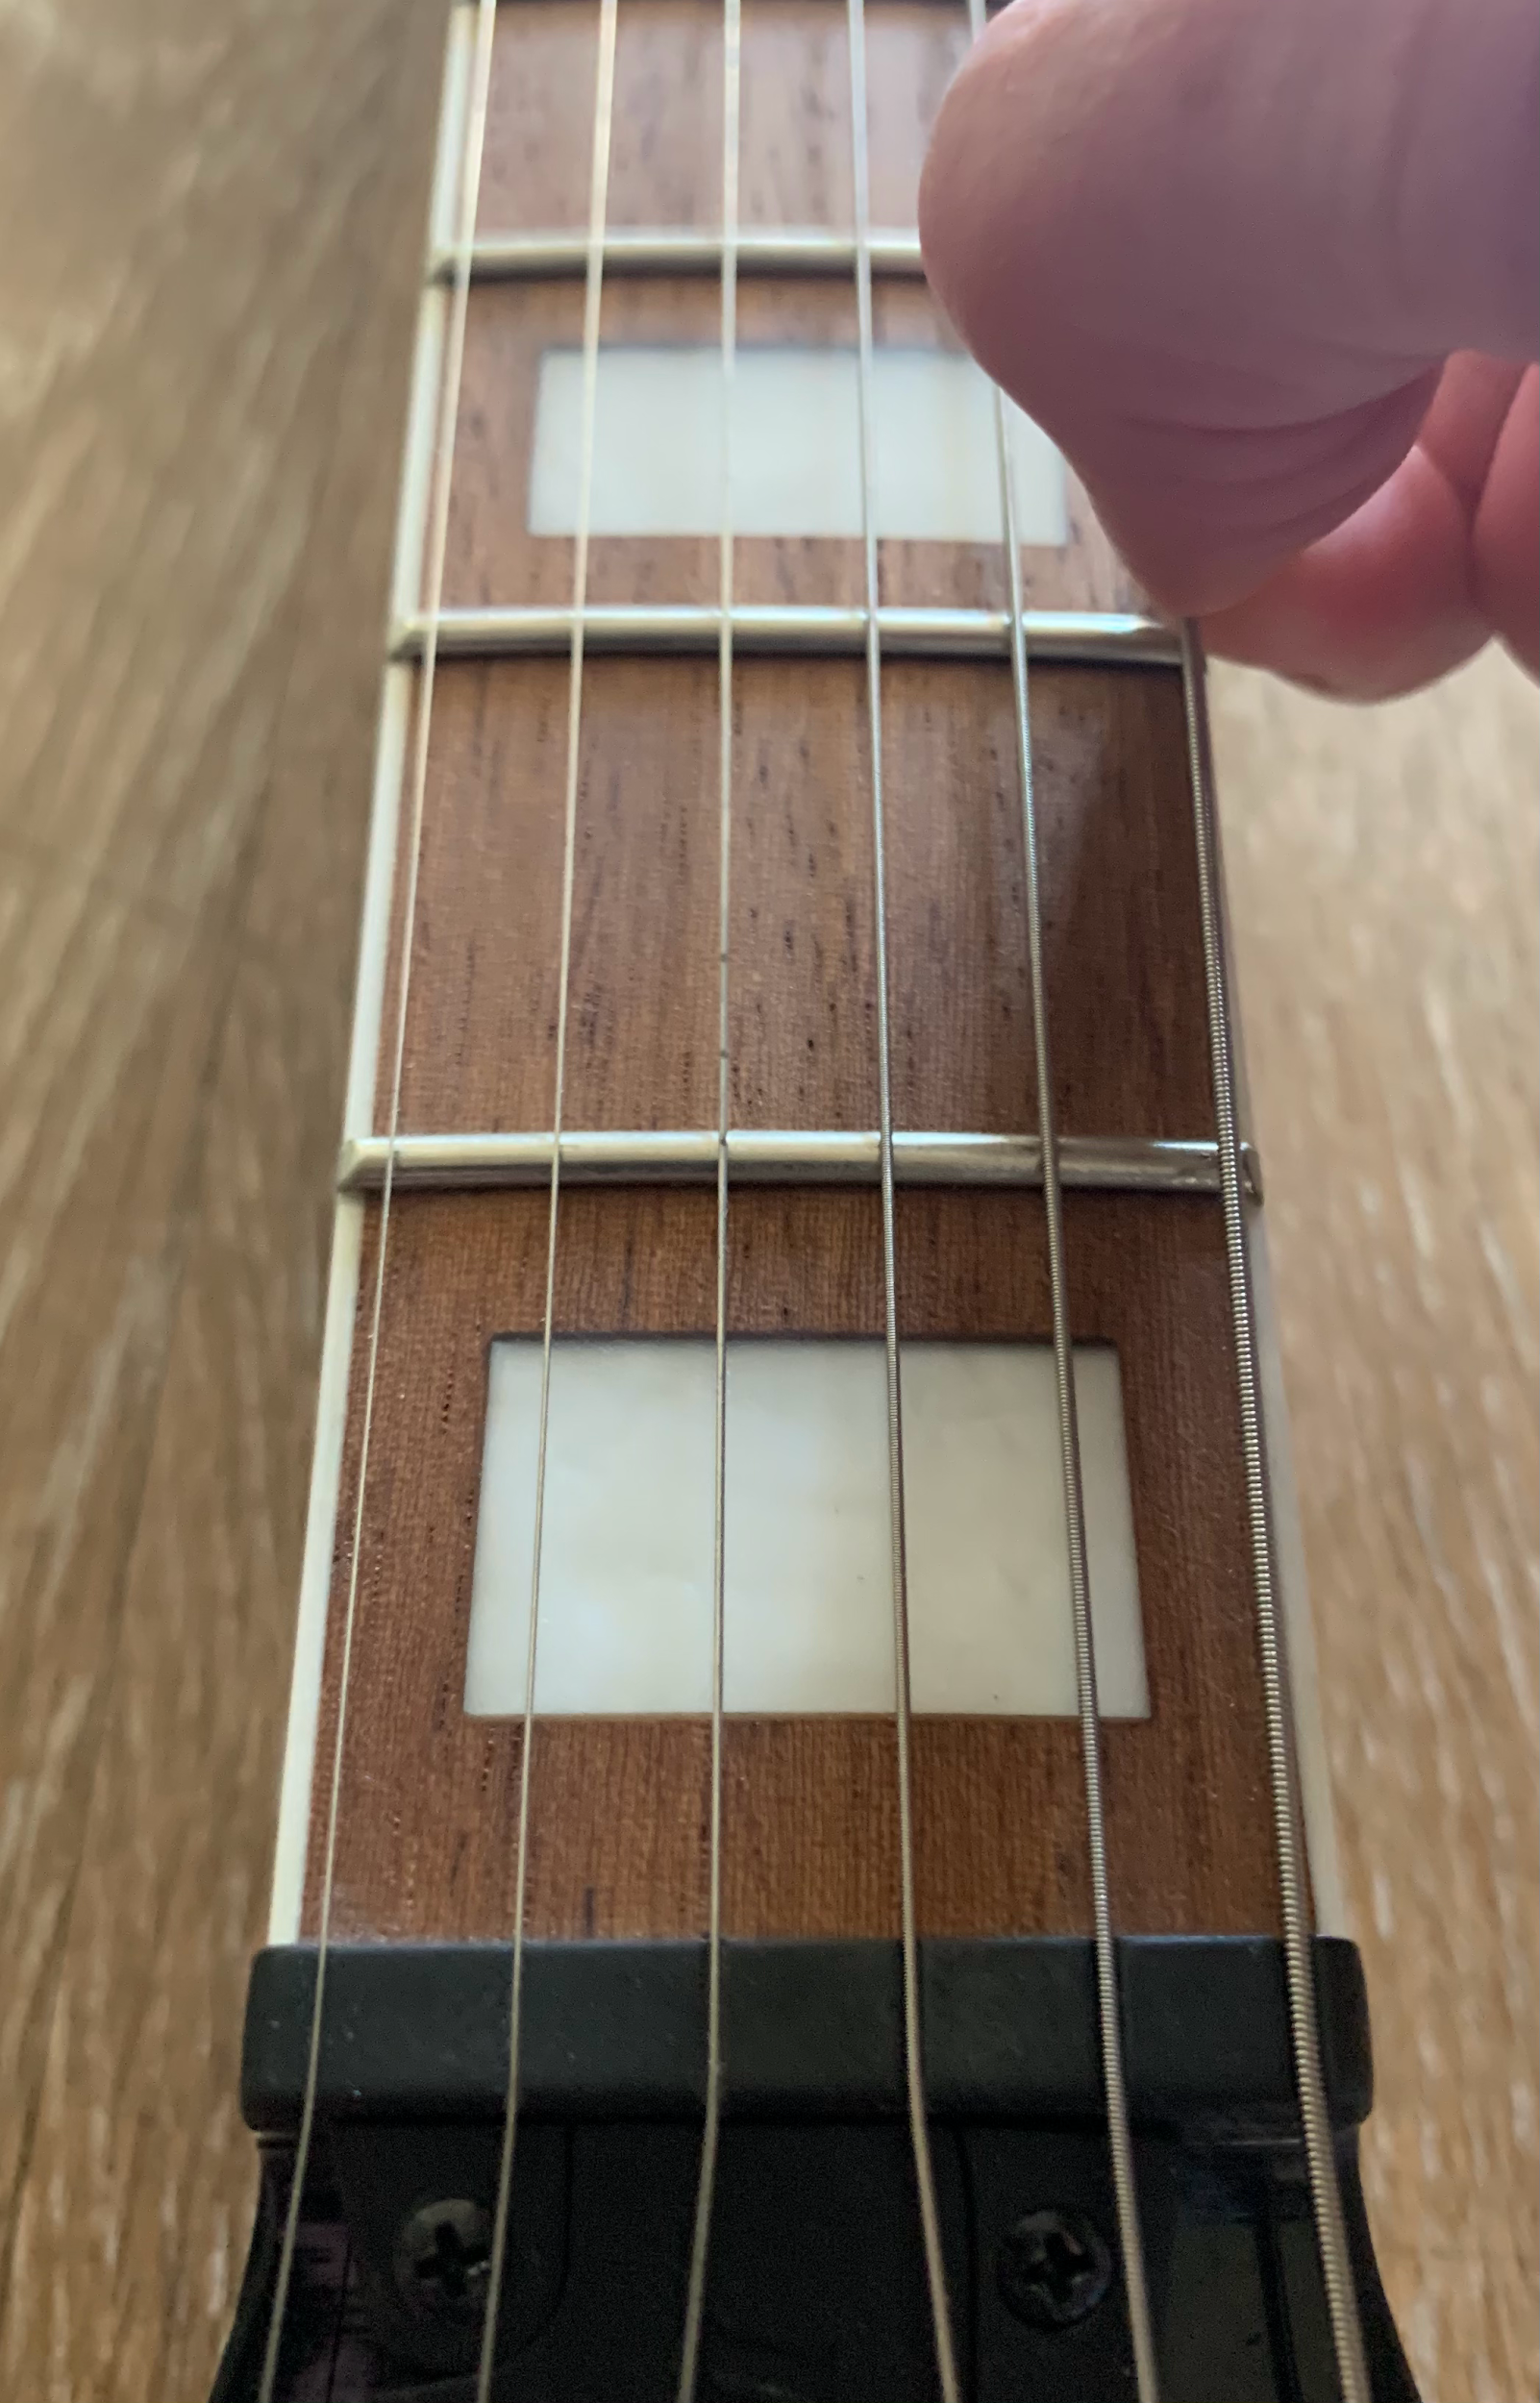
Method
Equipment
Arduino Uno R3 controller board
Breadboard
Jumper Wires
Electret Microphone Amplifier MAX4466 Module Adjustable Gain Blue Breakout Board for Arduino
Phone with audio recordings
Phone stand
Power source
Laptop with Arduino software
Acoustic and Electric guitars
Acoustic/Brass
Electric/Steel

Slide 7


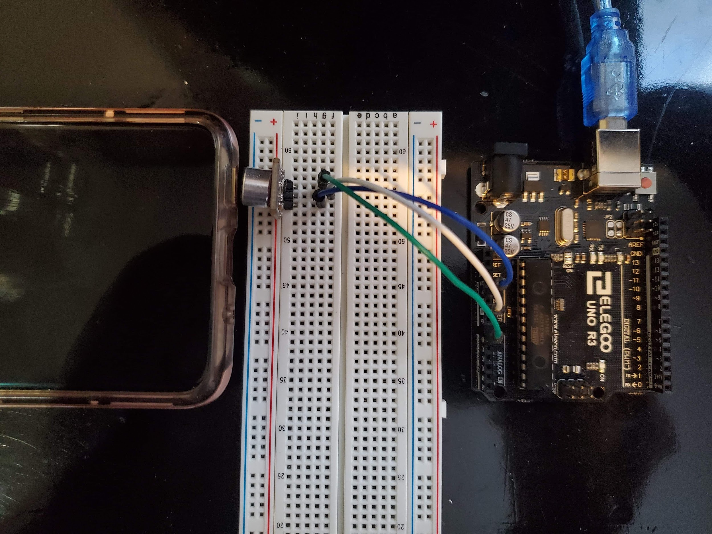
Experimental Setup and Procedure
Soldering
Wiring
Arduino Code
Experimental Setup
Data collecting
Analysis

Slide 8
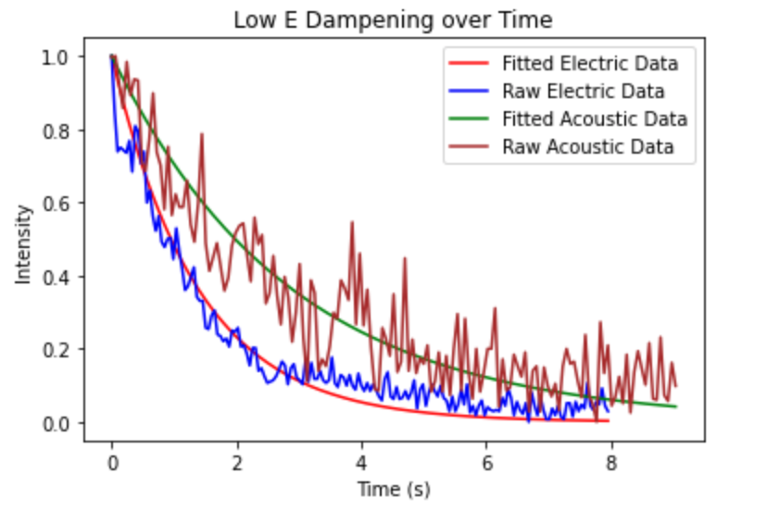
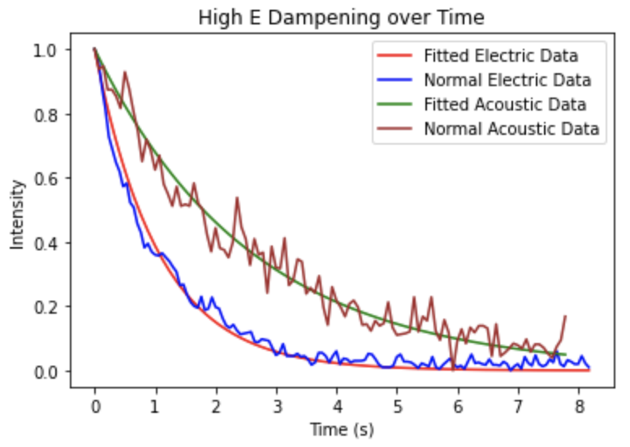
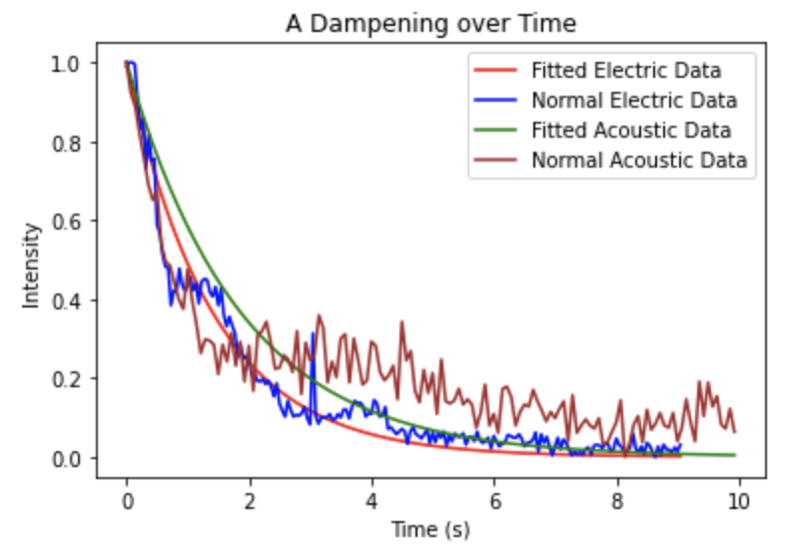
Analysis - Codegoing to have 3 graphs here and next page
Guitar Type | Tao - Low E | Tao - High E | Tao - A
Electric/Steel | 1.37 | 1.05 | 1.40
Acoustic/Brass | 2.85 | 2.59 | 1.85
Plots with Normalized, and Fitted Curves for Acoustic and Electric Guitars, Intensity on Y-axis with respect to time on X-axis.

Slide 9
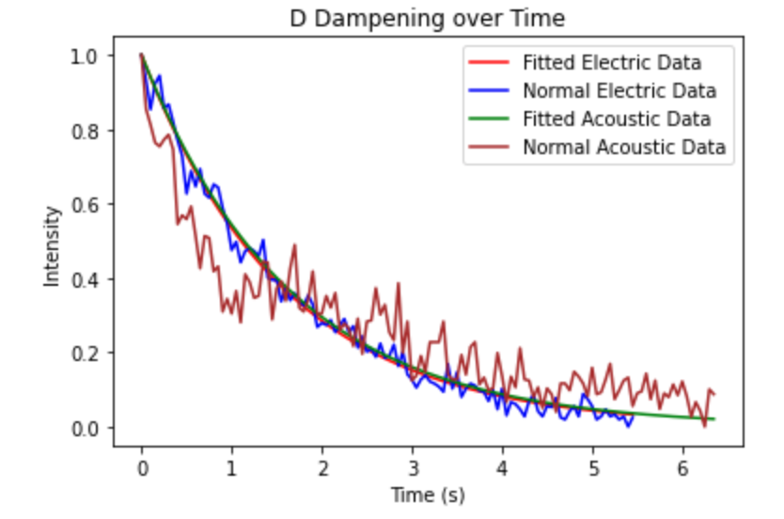
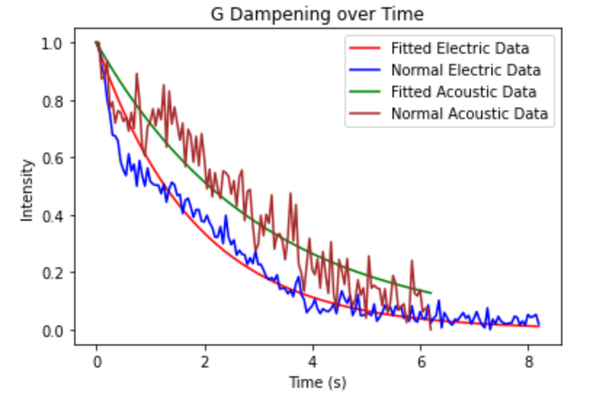
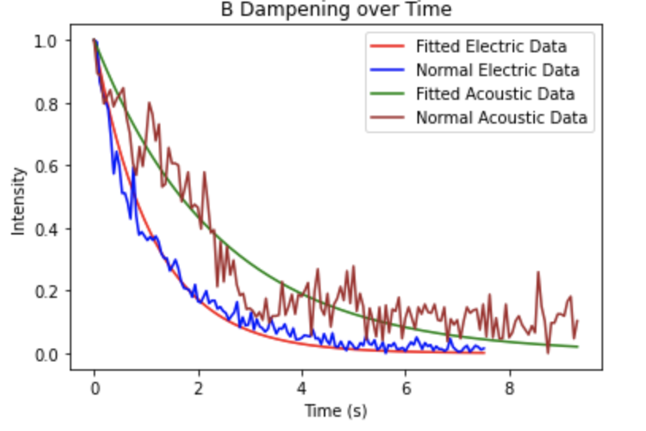
Analysis
Guitar Type | Tao - D | Tao - G | Tao - B
Electric/Steel | 1.59 | 1.83 | 1.13
Acoustic/Brass | 1.63 | 3.01 | 2.4
Plots with Normalized, and Fitted Curves for Acoustic and Electric Guitars, Intensity on Y-axis with respect to time on X-axis.

Slide 10
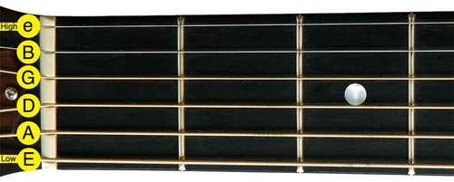
Analysis of Amplitudes/Frequencies
Please Note Initial Amplitude Based on Amplitude Normalized to 1 Cm, intended frequencies from MTU.edu
Note | Electric Initial Amplitude (Cm) | Acoustic Initial Amplitude (Cm) | Electric Error from Intended Frequency (%) | Acoustic Error from Intended Frequency (%)
Low E | .877 | .92 | 1.1% | .7%
A | 0.94 | 0.65 | .9% | .9%
D | .99 | 0.74 | 1.9% | .1%
G | 0.86 | 0.98 | 1.5% | .3%
B | 0.92 | 0.94 | 1.2% | .4%
High E | 0.92 | 0.96 | .6% | .2%

Slide 11

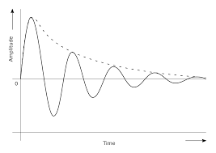
Conclusion
The experimentally collected data supports our hypothesis that the linear mass density and harmonic number are proportional to a guitar sound waves decay constant and oscillation frequency.

Slide 12
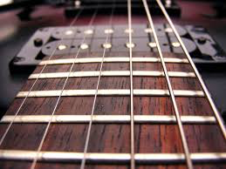

Sources of error
Systematic errors:
Playing a pre recorded audio file
Modeling the string-guitar system without any internal resistance
Assuming gamma is a constant
Acoustic vs Electric Build (ie. Acoustic is Hollow-Bodied)

Slide 13

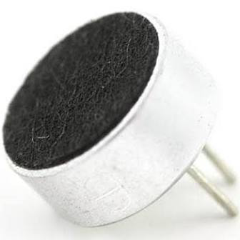

Random errors
The Arduino’s connection to the computer
The position/strength of the guitar string player’s finger
The efficacy of the Arduino microphone
Qualities of the medium (ie. temperature, humidity)

Slide 14
Implications and magnitude of results
Our results illustrate that a guitar sound wave can be accurately modeled as a damped linear oscillator (one variable), and has a tau decay constant proportional to intrinsic properties of the sound wave!
There is a higher average Tau for the acoustic guitar
Guitar/String design

Slide 15
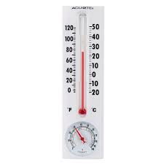


Future research
Conduct the same experiment but vary the temperature in the environment by an integer number of kelvin
2. Conduct the experiment in fluids of varying viscosities-water, oil, etc..

Slide 16
Thank you for listening to our presentation!
Questions?

Slide 17
References?

